Slide 1
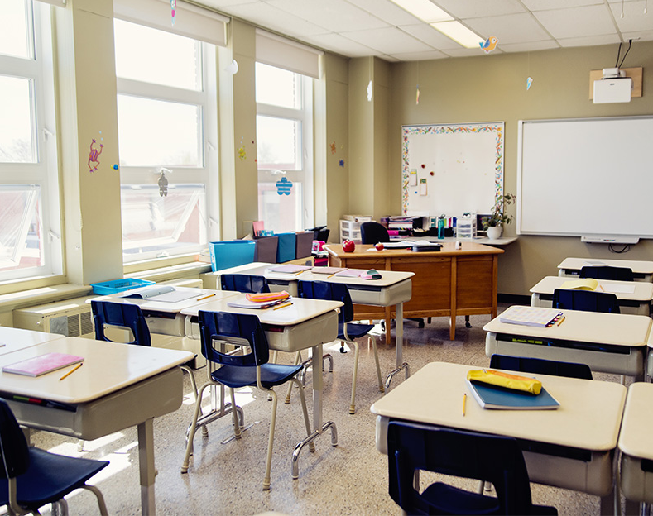
STUDENT ATTENDANCE MONITORING USING FACIAL RECOGNITION IN A CLASSROOM 10th Feb 2021
15EC496L – Major Project
Batch number:12
Team members
1) K CHANDRASEKARAN RA1711004040028
2) S AATHITH RA1711004040030
Guide: Dr. S.Karthtik

Slide 2

Abstract
Monitoring the attendance of students is one of the major concerns in many educational institutions. The manual management of the attendance sheets is time consuming. Other existing methods( RFID, Biometrics, etc.) of taking attendance also consumes a finite of amount of time which can be used for other productive action and also has several disadvantages associated with it. Facial recognition solves some of the problems that exist in the previously mentioned attendance systems. We proposed a solution that uses facial recognition and makes sure that there is a minimal interaction between students and the attendance monitoring system.
Keywords – Facial recognition, computer vision, Smart Attendance monitoring.

Slide 3

Existing problem
Student’s attendance in the classroom is a very an important task.
The existing method of taking attendance consumes a finite of amount of time which can be used for other productive action.
We are focused on addressing this problem on schools and universities only. But also can be extended for organization.

Slide 4
Motivation
We found this problem in many universities and schools.
We want a reliable system which identifies which student is present in the classroom and gives the attendance based on his presence.
This system must not be complex and very easy to interact with it.

Slide 5
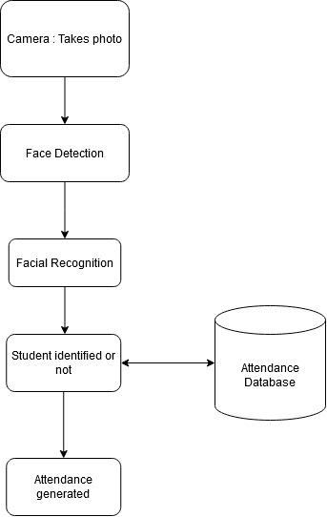
Methodology & Flowchart

Slide 6
References Papers
C. Ding and D. Tao. Trunk-branch ensemble convolutional neural networks for video-based face recognition. IEEE Trans Pattern Anal Mach Intell, 40(4):1002–1014, apr 2018.
Y. Chen, Y. Tai, X. Liu, C. Shen, and J. Yang. FSRNet: End-to-end learning face super-resolution with facial priors. In 2018 IEEE Conference on Computer Vision and Pattern Recognition (CVPR). IEEE, 2018.
https://www.learnopencv.com/face-detection-opencv-dlib-and-deep-learning-c-python/
https://www.electronicscomp.com/raspberry-pi-8mp-noir-camera-module-v2-india?gclid=CjwKCAiA2O39BRBjEiwApB2Ikjhc_K3Lxq-xtrgZNZA4mhJy12pRJj8mdGWV0sX2t-iGZRdeBfWyRBoCfuAQAvD_BwE

Slide 7

Thank You

